Slide 1
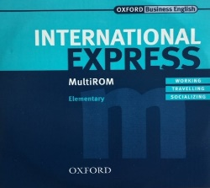


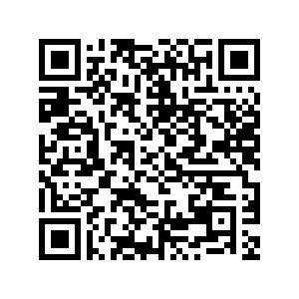
It’s your right
Do you need a
phonetic alphabet?
r ə ɪ i æ Ɵ ð
It’s not hard
It’s useful
To create
your
own
accent
Decide who the accent must serve —
Listen to existing created accents
interlocutors, the student,
the teacher?
Practice and get corrective feedback
Your students will thank you

Slide 2
Problem: Uncertainties about teaching pronunciation
What should I teach? There is no official dialect of English and there are several standard dialects of English (UK, US, …).
Teaching pronunciation isn’t needed. Non-native pronunciations are OK and correcting pronunciation hampers students’ willingness to speak.
My students and their interlocutors come from all over the world, so it is best not to teach any accent; I focus on comprehensibility only.
The International Phonetic Alphabets (IPAs) don’t represent my accent.
The IPAs are not logical; I don’t feel comfortable explaining them.
The IPAs are too much trouble; students have enough work learning English spelling to sound correspondences.
How should I teach pronunciation? It’s not like teaching syntax and it’s hard for students to improve their pronunciation on their own.

Slide 3


Accent: Specifically…
A0 A1 A2 B1 B2 C1 C2
Adult production of sounds for communicating in Brussels, Belgium
Students’ (non-native) accent is due to pronouncing English (EN) sounds the same way as they pronounce their native language’s speech sounds (interlanguage)
r ð ɵ

Slide 4
Deciding what sounds to teach:
What pronunciation do students need and want to learn?
Ask the students:
Who are the students’ target interlocutors?
What are the students’ goals in speaking English?
  To be comprehensible to native and non-native English speakers?
  To have a particular accent? (UK, US, …)
  To not have a particular accent (French, Dutch, …)
Note: Students to not need to produce their interlocutors’ accent; they need only to understand them.

Slide 5
Deciding what sounds to teach:
What pronunciation do students need and want to learn?
Ask the students:
Who are the students’ target interlocutors? 80% non-native EN speakers
What are the students’ goals in speaking English?
  To be comprehensible to native and non-native English speakers
  To have a particular accent? (UK, US, …): a neutral accent
  To not have a particular accent: their native language accent
+ 3. The teacher judges how comprehensible the students’ pronunciation is.
-> Decision on what, how, and how much time to teach pronunciation.

Slide 6

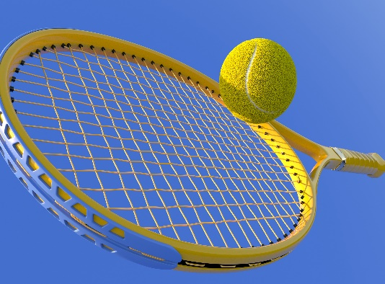
Pronunciation is a motor skill
>
Language 1
English
40 repetitions > start a habit > partial transfer > 100% transfer into speech
Sound > sound in context (add leftwards) > syllable start alternation
h > hat > hard hat > a hard hat > I have a hard hat
Correction or check against a standard

Slide 7
To create a neutral accent 1
lingua franca
1. All sounds and all minimal pairs must be comprehensible as English.
2. Use a standard dialect as a base, usually the teacher’s own accent.
3. Identify sounds whose pronunciation will deviate from the standard dialect.
4. Demonstrate the pronunciation of every sound once by putting it into words and showing the spellings. Explain the sounds that some students may wish to pronounce differently to create their own accent and say why.
5. Tell students when their sounds are incomprehensible.
o r ə ɪ i ɛ e æ ð ɵ
5 to 8 sounds usually: o r ɛ e æ

Slide 8
To create a neutral accent 2
6. The sound should be pronounced as in at least one native dialect of English
/o/ as in ’note’: Scottish English [o] rather than [əƱ]
7. Prefer easy, simple pronunciation: one speech movement, not two.
8. Prefer easy = familiar (similar to the student’s native language sound)
9. Take advantage of the written word.
For English letter (’o’), which usually corresponds to the English pronunciation [o, ow], prefer the English pronunciation that is similar to the way foreign languages pronounce that same letter:
'o' as in 'note': 'o' in French text is pronounced [o], ES [o], NL [o] > [o]
’r’ as in ’red’: ’r’ in NL is pronounced [r], in US EN [r] > reduce FR [ʁ]

Slide 9
International Phonetic Alphabets (IPAs): Yes or No?
Only when needed: for 5 to 12 hard or created sounds or minimal pairs
1. Explain to students: English spelling to sound correspondence is unreliable: one letter can mean many pronunciations. Therefore an IPA.
2. Explain: There are different dialects of English. We can create our own accent from the set of pronunciations. Therefore minor differences from IPA.
3. Explain to the student that they do not need to learn the alphabet.
4. Use the IPA in the textbook or pick the IPA that best conforms to the pronunciation you will teach. Choose your poison.
5. Note that most UK IPAs use [e] for the sounds in ’met’ and ’mate’, even though Cambridge and Oxford online dictionaries do not pronounce the same vowel in the two words. This confuses everybody and discourages teachers from using IPAs in class.

Slide 10
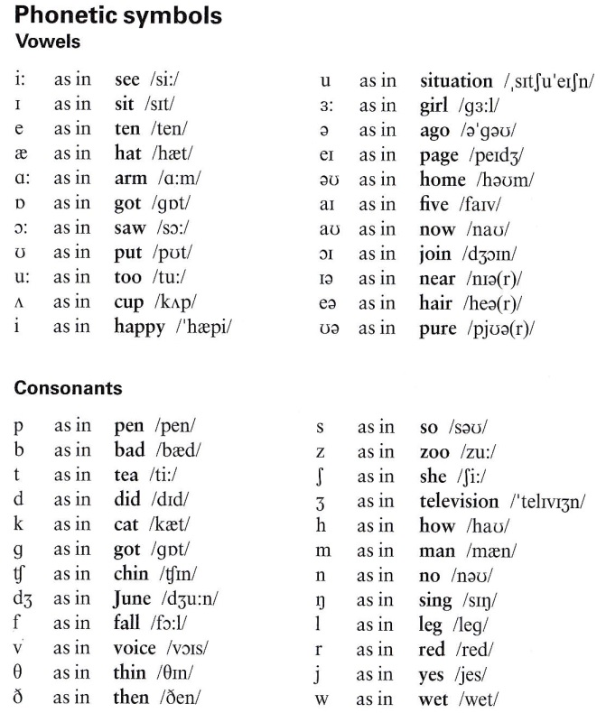
International Express Elementary

Slide 11
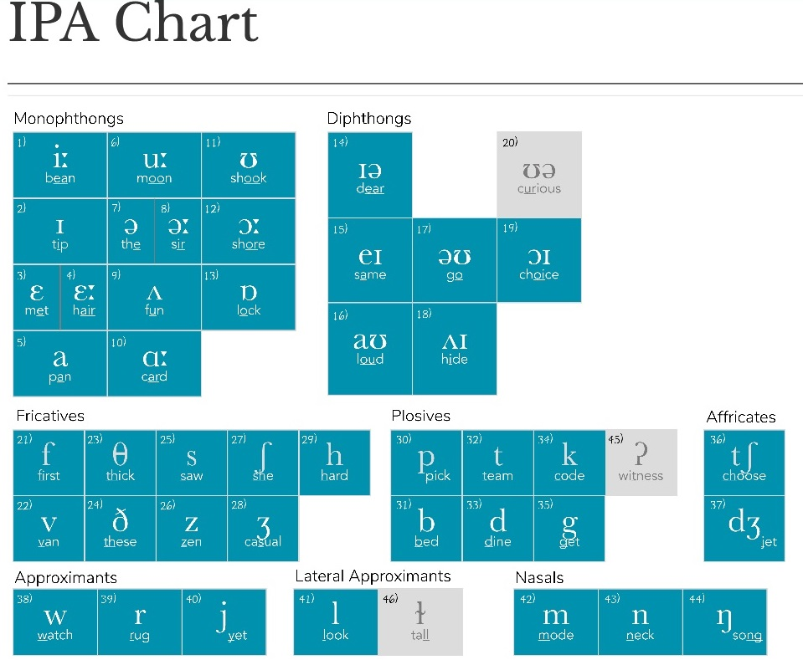
Pronunciation Studio

Slide 12

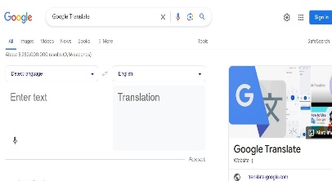
Pronunciation practice and feedback: Speech Ace
A free online automatic speech recognition tool for testing, scoring and practicing pronunciation
Aims: comprehensibility and fluency
Speech sound scoring and feedback
Sentence and paragraph scoring and feedback
Google Translate allows practice, but its goal is to comprehend even if pronunciation is faulty, so it may give a false sense of correctness to students

Slide 13
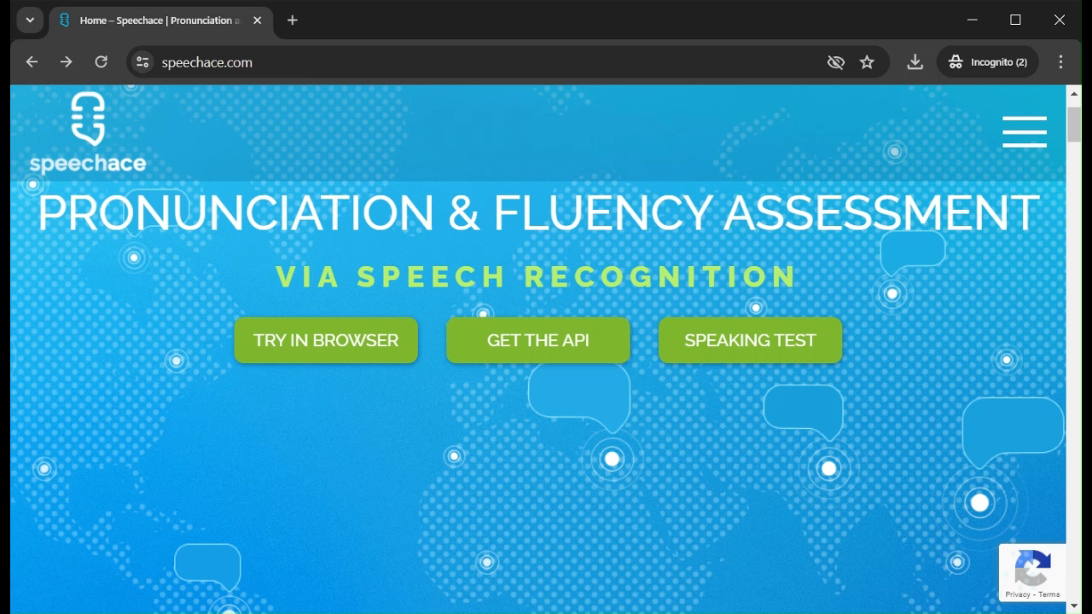

Slide 14
Pronunciation practice and feedback: Speech Ace
A free online automatic speech recognition tool for testing, scoring and practicing pronunciation
Aims: comprehensibility and fluency
Speech sound scoring and feedback
Sentence and paragraph scoring and feedback
Google Translate allows practice, but its goal is to comprehend even if pronunciation is faulty, so it may give a false sense of correctness to students

Slide 15


Slide 16
Pronunciation practice and feedback: Speech Ace
A free online automatic speech recognition tool for testing, scoring and practicing pronunciation
Aims: comprehensibility and fluency
Speech sound scoring and feedback
Sentence and paragraph scoring and feedback
Google Translate allows practice, but its goal is to comprehend even if pronunciation is faulty, so it may give a false sense of correctness to students

Slide 17
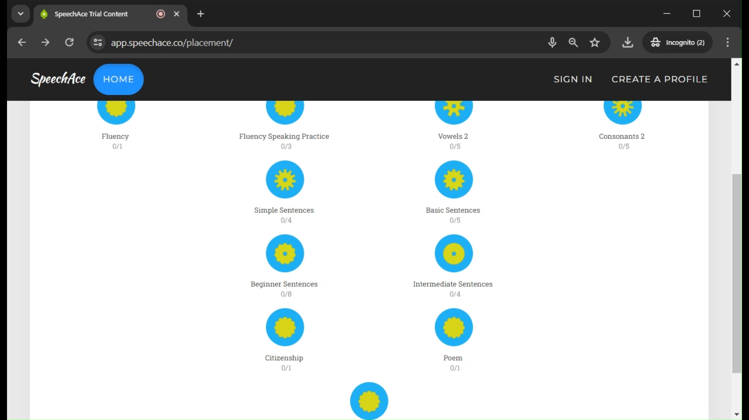

Slide 18
Pronunciation practice and feedback: Google Translate
A free online automatic speech recognition tool for testing, scoring and practicing pronunciation
Aims: comprehensibility and fluency
Speech sound scoring and feedback
Sentence and paragraph scoring and feedback
Google Translate allows practice, but its goal is to comprehend even if pronunciation is faulty, so it may give a false sense of correctness to students

Slide 19
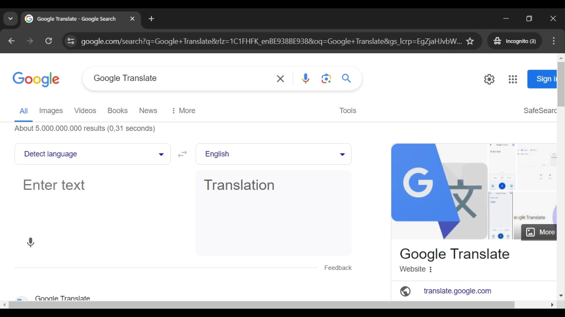

Slide 20
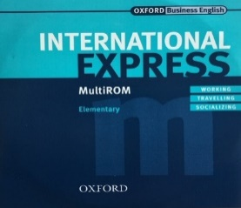
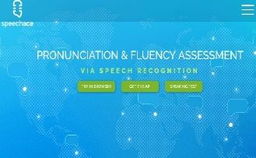
To create your own accent
Decide what sounds of a standard dialect need to change
- Ask students and apply your own judgment
- Aim for comprehensibility
Decide how to teach speech sounds
- Only the most necessary IPA sounds
- Choose a properly phonetic IPA or adapt an IPA
Teach sounds for accent and (some) for comprehensibility
Use already existing created accents as models
T Get feedback from automatic speech recognition tools
Practice 40x > Habit > Automatism
5–8
o r
o r
r ə ɪ i æ Ɵ ð

Slide 21
References
Scottish o monophthong
https://en.wikipedia.org/wiki/Scottish_English
https://en.wikipedia.org/wiki/French_phonology
https://en.wikipedia.org/wiki/Dutch_phonology
https://en.wikipedia.org/wiki/Spanish_phonology
https://socialsci.libretexts.org/Courses/Canada_College/ENGL_LING_200_Introduction_to_Linguistics/02%3A_Sounds_Part_1-_Phonetics/2.04%3A_IPA_and_Charts
SpeechAce:
A test: scores spoken pronunciation, fluency, grammar, and
Pronunciation exercises: score a speaker's pronunciation of a word
Fluency exercises: score a speaker's pronunciation of connected text

Slide 22
References
Munro, MJ & Derwing, TM, 2015. Intelligibility in Research and Practice: Teaching Priorities, in Reed, M and Levis JM (eds), The Handbook of English Pronunciation, John Wiley & Sons.
Tegnered, A & Rentner, J, 2021. Teachers’ Views on Teaching English Pronunciation — A Phenomenographic Study of Upper-secondary Teachers’ Views and Reported Practices. Thesis 2 Linköping Universitet.

Slide 23
Backup
Some standards for speech perception:
Cambridge Learners' English dictionary (UK and US pronunciation)
Oxford Learner's Dictionaries
https://pronunciationstudio.com/English-IPA-chart/ (UK pronunciation)
'XXXX' pronunciation (Google search window: no practice window)
The International Phonetic Alphabets
  [o] https://en.wikipedia.org/wiki/Close-mid_back_rounded_vowel
International Express-Elementary (native Belgian speakers of English
Pronunciation Studio
LearningApps (synthesize different accents in English: FR NL ES IT RU…)
IDEA database (International Dialects of English Archive)
  Received Pronunciation 4 , Indian, Chinese, etc.
How to have a … accent (Gareth James videos on YouTube)
BBC individual sound pronunciations (received pronunciation)

Slide 24
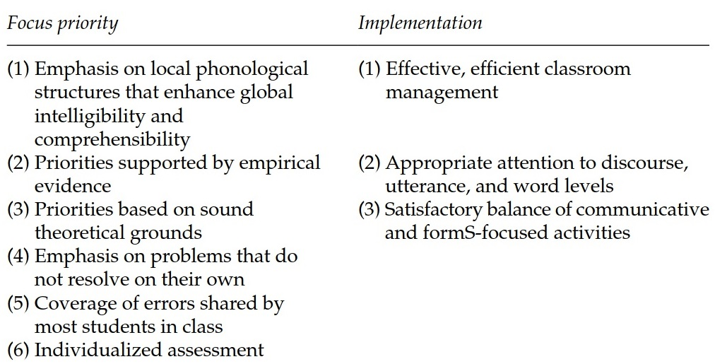
Munro & Derwing 2015: Pronunciation Teaching Priorities

Slide 25
My own work
Grover, C. (2021). Which model of synthesized English do English teachers want for a lingua franca? Language Issues, 32.1 (Summer), 34–47; Language Issues, 31.2 (Winter), 39–49. [2 papers]. Experiment at https://learningapps.org/watch?v=p8v1kt93320
Grover, C. (2020). EN games: https://www.bruxellesformation.brussels/jeux-langues/story_html5.html
Grover, C. (2019). Learning English in Belgium. In Learning English in European countries. Special Edition 2019. Language Issues 30.2, 42–44.
Fackrell, J., Vereecken, H., Grover, C., Martens, J-P., Van Coile, B. (2002). Corpus-based development of prosodic models across six languages. Improvements in Speech Synthesis. COST 258: The Naturalness of Synthetic Speech. Keller, E., Bailly, G., Monaghan, A., Terken, J. & Huckvale, M. (eds.). John Wiley & Sons, England. pp.176–185.
Grover, C., Jamieson, D.G., & Dobrovolsky, M.B. (1987). Inton­ation in English, French, and German: Perception and produc­tion. Language and Speech, 30, 277–295.

